Slide 1



Fabric push button for Hospitals
Interactive systems – sose20

Slide 2

Project description
The impact of Coronavirus in the world is unimaginable. During these times we need to come up with a system that would greatly increase the efficiency of the hospitals. The smart gown is one of the ideas which would help in this. The fabric button is embedded in the hospital’s patient gown. So, with the touch of the patient, it can invoke a sound and we can extend to have a centralized system that tells which device has requested using TCP/IP.

Slide 3
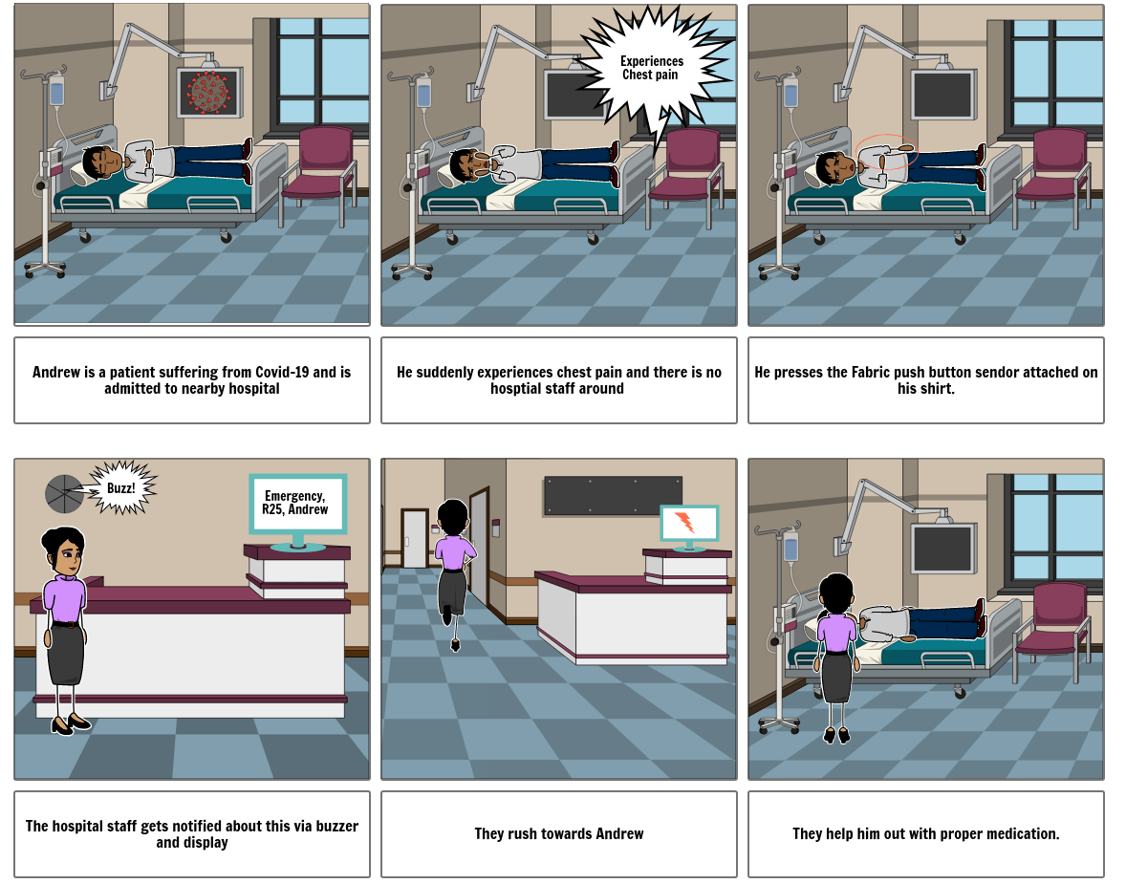
Storyboard for better understanding

Slide 4
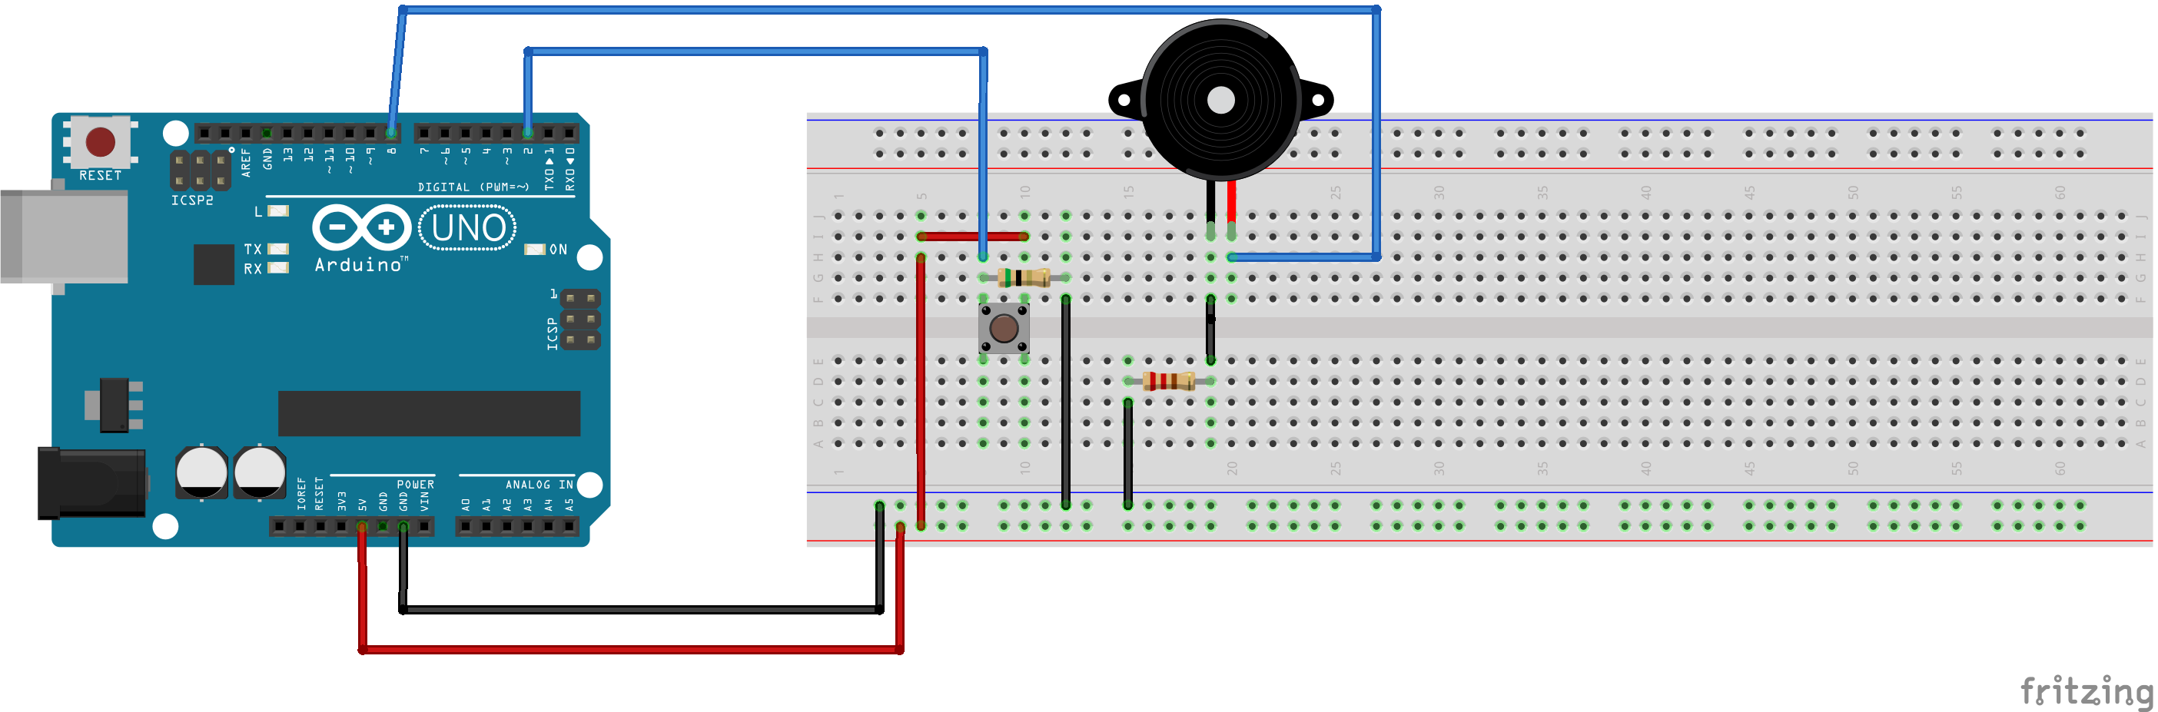
Prototype
The basic circuit diagram is done on Fritzing. Source code is written for it and then simulated in Tinkercad.
The push-button is connected to digital pin 2 and the buzzer is controlled using pin 8 of the Arduino UNO board. The pins are configured and coded in such a way that when a button is pressed the buzzer will buzz.

Slide 5
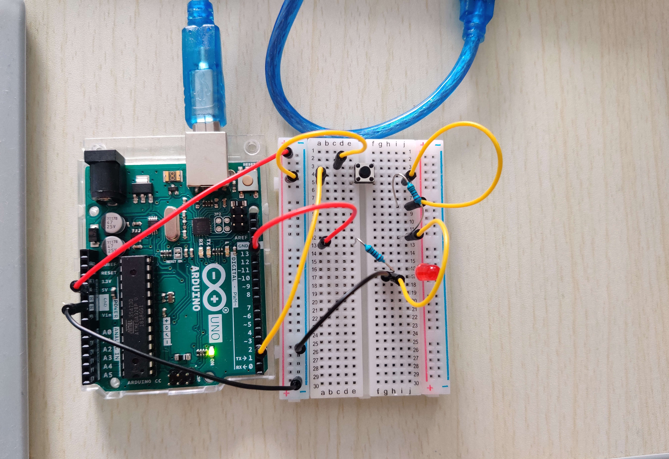
Prototype
In the next prototype, the same setup was implemented using UNO and LED.
In the further development, the push button will be replaced by fabric push button and LED by buzzer.
For the extended solution, there will be data transfer of the patient name and ward number to the main server.

Slide 6
Challenges
As of the current state there are not much of challenge as the development is not yet full fledged started.
Pressure sensor threshold configuration to act as push button.
Making use of spacer material at right proportion so that it serves the purpose of insulation.
Future challenges would be configuration of IOT between devices as we need a microcontroller with 802.11 to transfer data.
Lack of materials and on time delivery of the product ordered.

Slide 7
Current status
The setup is simulated and tested on Tinkercad.
The setup is implemented using UNO and LED.
The current status of development is ahead of proposed schedule.
The physical implementation of sensors has already started with the available materials.

Slide 8
Open questions
There are major ambiguity over the tapping of signals from conductive fabric. As there are many methods which involve soldering or heating the fabric to put the wires. Also with respect to the type of wire to use. This would be eventually solved with proper research on the material.
There are ambiguity with respect to the spacer material used. Either to use Velostat or fusible interfacing material.

